Slide 1
Bleed Orange, Measure Purple
03/12

Slide 2
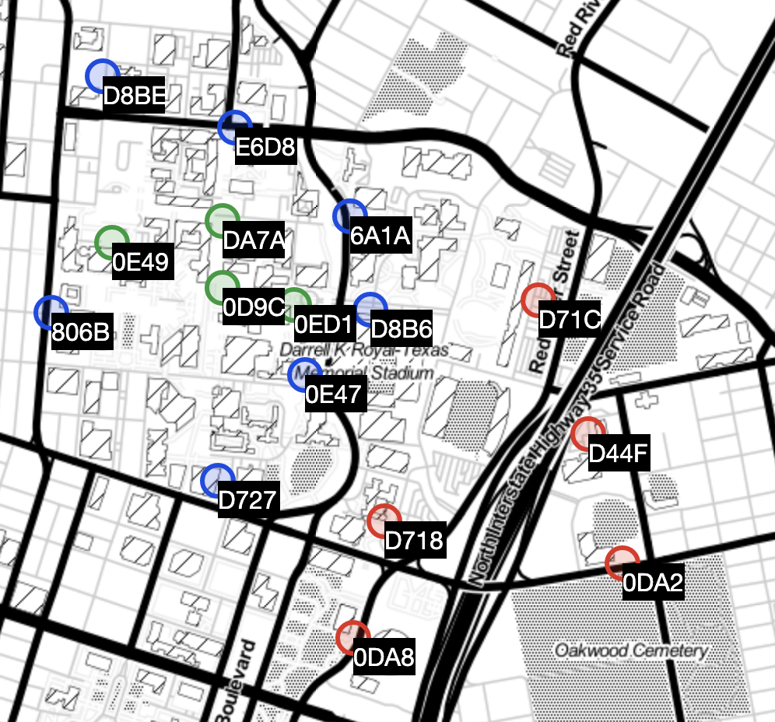
Low-Cost PM2.5 Sensor Network
16 sensors on UT Campus
Purple Air map
Plantower PMS Sensors

Slide 3
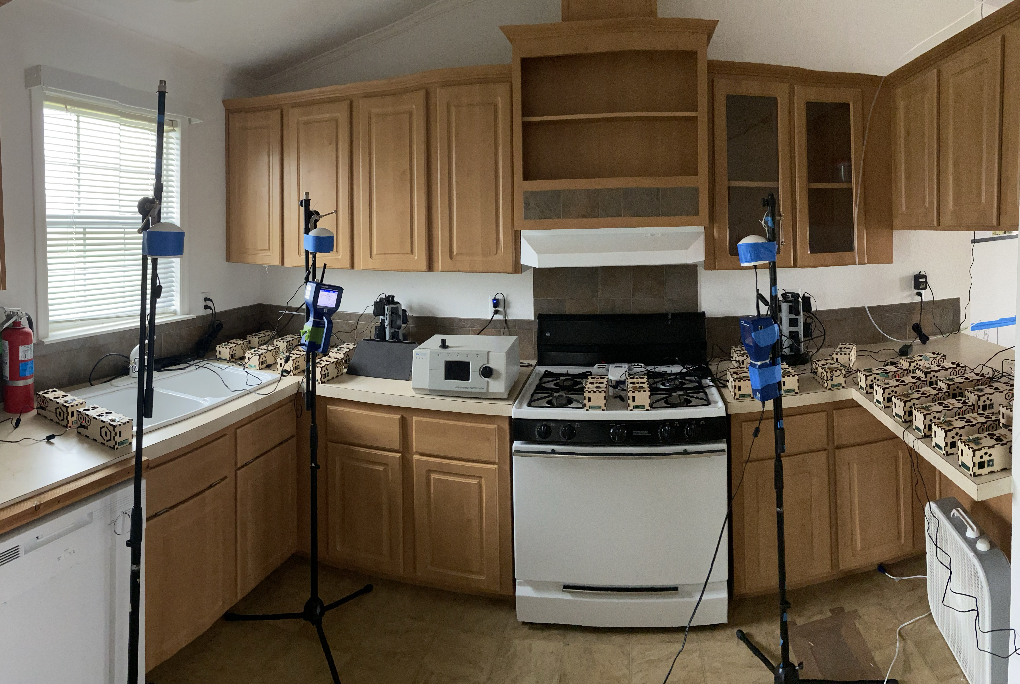
PM Tests

Slide 4
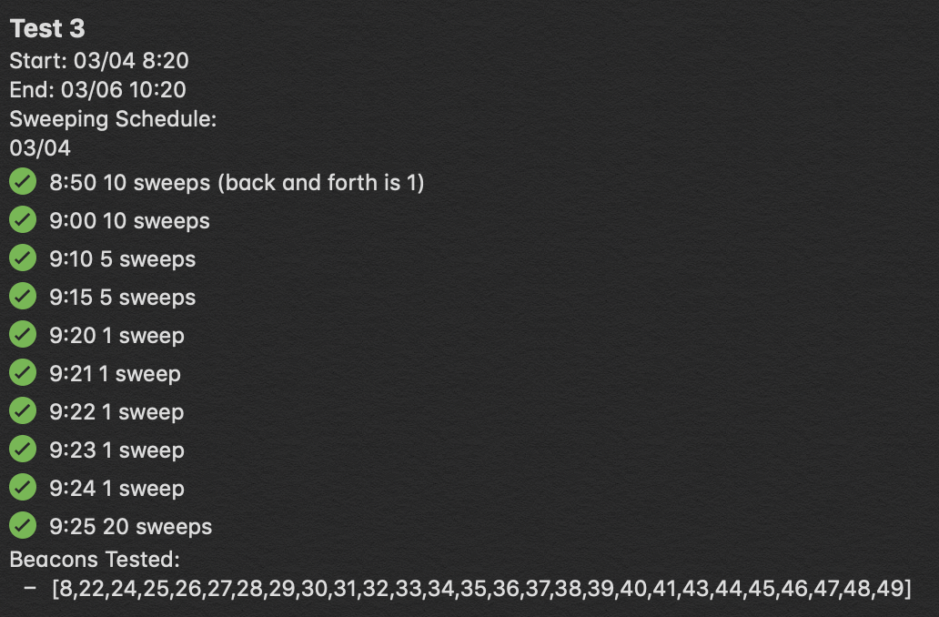
Old Test Information

Slide 5
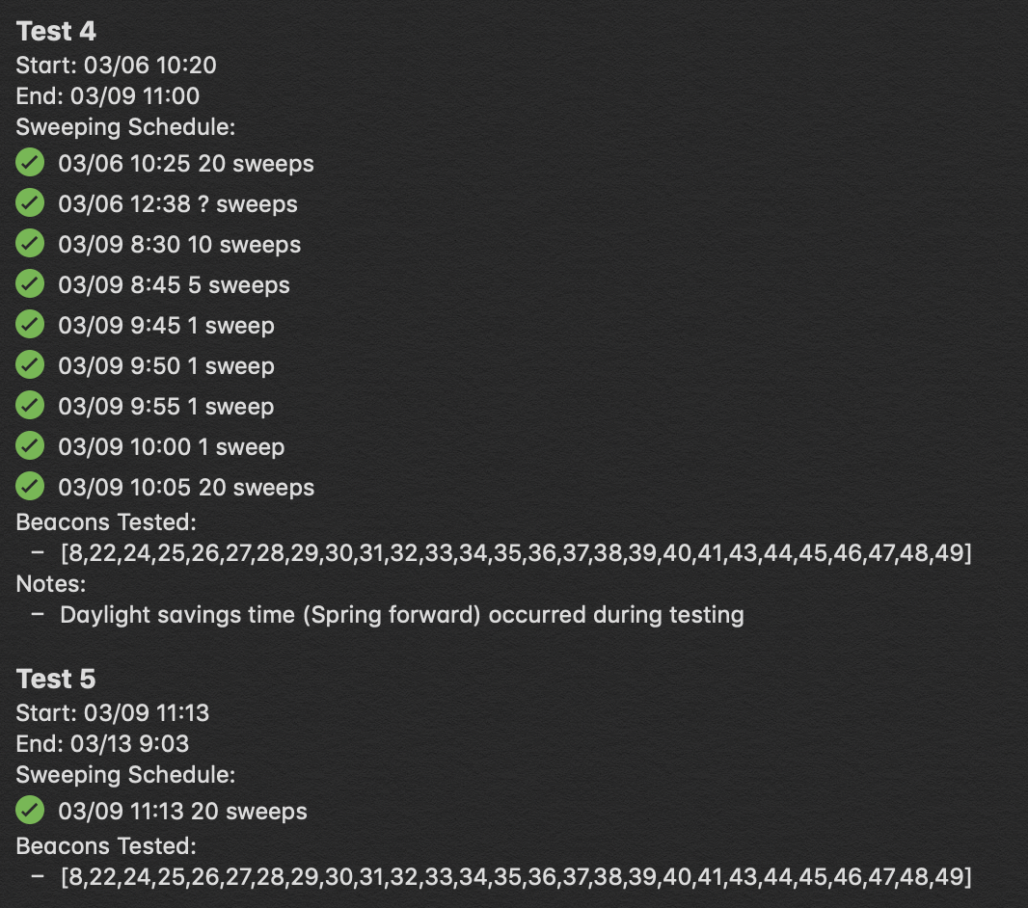
Updates
PAs at PRC gathering data!
Data collection from Wed 03/04 – Fri 03/06
I will give you more APS

Slide 6
Tasks for Calvin
Time series comparison
Average APS and PA data on same timeframe
Overlay the graphs to see if they align
Multivariate Linear Regression
Different visualizations?
Ways to improve?

